Slide 1
ANGULAR WORKSHOP
Anilal Sambasivan

Slide 2
Agenda
Framework vs Library
What is Angular?
Angular Versions
Why Angular?
Where does Angular fit?
Angular CLI
TypeScript
Angular Building Blocks
Setting up Dev Environment
Components
Decorators
Modules
Data Binding
Directives
Pipes
Component Interaction
Services
Routing
Observables
Forms
Server Communication

Slide 3
What are Frameworks?
Library vs Framework
Library
Your code is in charge
Collection of functions
Calls into the library when necessary
E.g. jQuery
Framework
Framework is in charge
Calls into your code when needed
E.g. Angular, Ember
Inversion of Control
Provide everything you need to develop an application
Force you to follow standard application structure

Slide 4
What is Angular?
Framework for building front-end Single Page JavaScript applications
Angular apps
Can run on desktop and mobile devices
Are generally SPAs
Open-source
TypeScript-based framework – supports built-in strong typing, classes, interfaces
Large community support and many open source re-usable components

Slide 5
Angular Versions
Angular 2
Component based architecture
Complete re-write of AngularJS, no backward compatibility to angular 1
Like angular 1.x Angular 2 is Modular, Maintainable and Testable

Slide 6
Angular Versions
Angular 4
Apps are smaller & faster
AOT compilation, Angular Universal – Isomorphic
Backward compatible with Angular 2
Released in Mar 2017
Angular 5
Smaller, faster and easier to use
Build optimizer, complier improvements
New HttpClient, pipes, router lifecycle events
Released in Nov 2017

Slide 7
Angular Versions
Angular 6
Multiple Export Alias
Angular Material & the CDK updates
Build Optimization
Bazel Compiler
Angular 7
Virtual Scrolling
Drag and drop
Improved application performance by removing the dev dependent polyfill codebase in production environment.

Slide 8
Why Angular?
Single Page Apps (SPA)
Better user experience
Reduced full page reloads
Better overall performance
Less network bandwidth
Proven software patterns and practices
Model View Controller (MVC)
Model View ViewModel (MVVM)
Dependency Injection (DI)
Declarative programming
Better readability, concise code
Better developer productivity
Faster development

Slide 9
Why Angular?
Component based
Reusable
Structures app code
Modular, Maintainable, Scalable
Cross platform, mobile support
Target multiple browsers, platforms & devices
Decouples DOM manipulation from app logic
Testable, TDD
Move app code forward in the stack
Reduces server load, reduces cost
Crowd sourcing of computational power

Slide 10
Traditional Web App
Request & Response
Web Server
Web Browser
URL Request to server
HTML
JavaScript
Response with Web page & Assets
Browser loads up entire web page
User clicks on link, new Request
HTML
JavaScript
Response with Web page & Assets
Browser loads up
entire web page

Slide 11
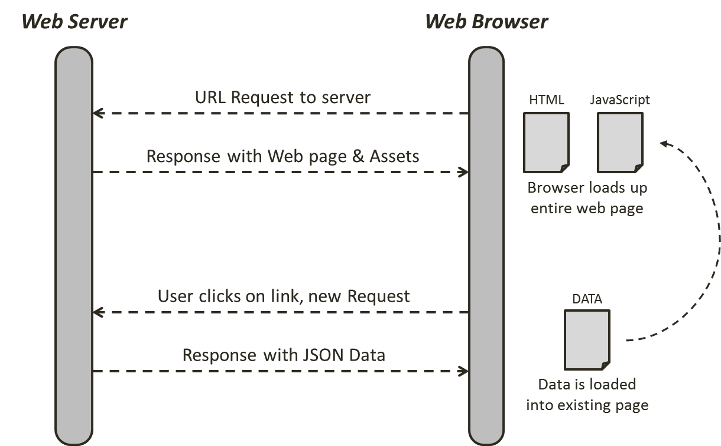
Angular App
Request & Response

Slide 12

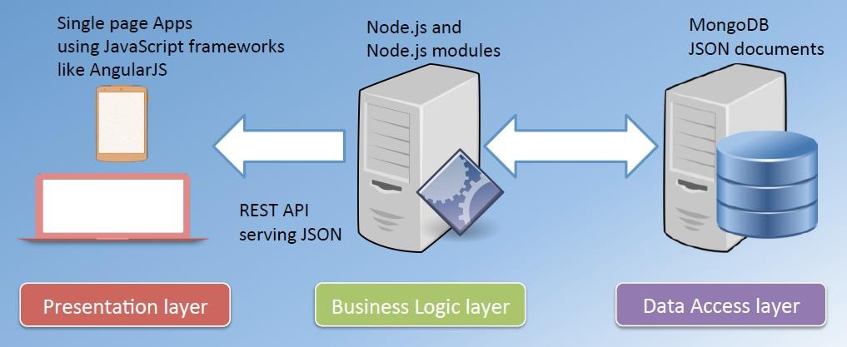
Where does Angular fit?

Slide 13
Angular CLI
Command-line interface tool to initialize, develop, scaffold, and maintain Angular applications.
Great tool for big Angular projects
Website: https://cli.angular.io
Wiki: https://github.com/angular/angular-cli/wiki
Requires Node.js
https://nodejs.org
npm install –g @angular/cli
ng new my-first-app
cd my-first-app
ng serve

Slide 14
TypeScript
Superset of JavaScript
Any valid JavaScript code is also valid TypeScript code
Offers more features over JavaScript
Types, Classes, Interfaces, Modules, etc.
TypeScript does not run in the browser, it is compiled to JavaScript (by CLI)
Chosen as main language by Angular
By far most documentation & example-base uses TypeScript
Why TypeScript?
Strong/Static Typing
reduces compile-time errors, provides IDE support
Next Gen JS Features
Modules, Classes, Import, Export, inheritance, method access modifiers
Missing JS Features
Interfaces, Generics, …
Targets multiple ECMA script standards
ES5, ES6 etc

Slide 15
TypeScript
Strong typing
More predictable and easier to debug
Object-oriented features
Classes, Interfaces, Modules, Properties, Generics, etc.
Compile-time errors
Great tooling
Intelli-sense
Installing TypeScript
npm install –g typescript
Transpile TS to JS
tsc some-program.ts

Slide 16
TypeScript
Declaring variables
var
const
let
Types
number
string
boolean
any
Type Assertions
<string>message
message as string
Arrow Functions
let log = (message) => console.log(message);

Slide 17
TypeScript
Interfaces
interface Point { x: number, y: number
}
Classes
class Point {
x: number; y: number;
draw() {
console.log(‘x = ’ + this.x + ‘, y = ’ + this.y);
}
}

Slide 18
TypeScript
Constructors
Optional parameters
Access Modifiers
public (default)
private
protected
Access Modifiers in Constructor Parameters
Properties
Getter
get X() { return this.x; }
Setter
set X(value) { this.x = value; }
Modules
export
import

Slide 19
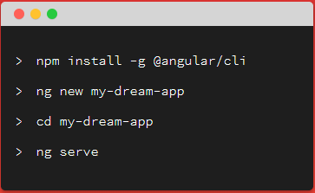
Setting up App with Angular CLI
Add Bootstrap to the project
npm install --save bootstrap
json-server --watch db.json

Slide 20
Setting up Angular App
Add reference to bootstrap.css
.angular-cli.json
In “styles” array, add a reference to “bootstrap.min.css”
For e.g., "../node_modules/bootstrap/dist/css/bootstrap.css"
How does an Angular app gets started?
index.html – Served by the server
main.ts – First file that gets executed
app.module.ts – Main loads this module
app.component.ts
Root component of the app
App module loads this component at the startup

Slide 21
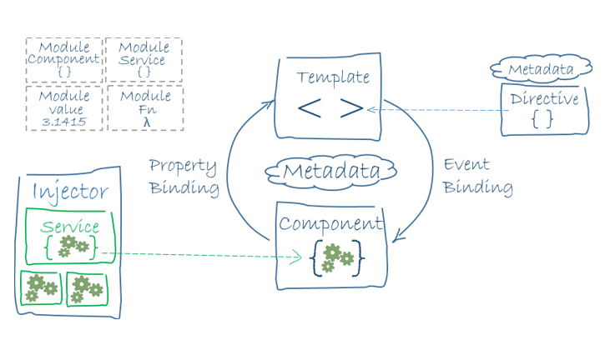
Angular Architecture

Slide 22
Angular Building Blocks
Components
Encapsulates the template, data and the behavior of a view
Completely decoupled from DOM
Directives
To modify DOM elements and/or extend their behavior
Built-in or custom
Pipes
Takes in data as input and transforms it to a desired output
Services
Encapsulates any non UI logic
Http calls, logging, business logic, etc
Any logic not related to a view is delegated to a service
Routers
Responsible for navigation from one view to another
Modules
A block of highly related classes

Slide 23

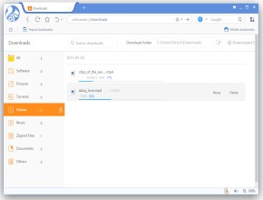
Basic Angular Application
Module
Directive
Template
Component
Service
Browser / View
Server
Pipe
Router

Slide 24
Components
App
NavBar
Sidebar
Products
Search
Product List
Product Form
Product Detail
Rating

Slide 25
Components
Key feature of Angular
Encapsulate the template, data and the behavior of a view
Allows you to break a complex web page into smaller, manageable & reusable parts
Plain TypeScript class
App component
Root component
Holds our entire application
Other components are added to App component
A Component has its own
Template – HTML markup
Style – CSS styles
Business logic (data and behavior) – TypeScript code
Promotes
Reusability
Maintainability
Testability

Slide 26
Components
Key feature of Angular
Encapsulate the template, data and the behavior of a view
Allows you to break a complex web page into smaller, manageable & reusable parts
Plain TypeScript class
App component
Root component
Holds our entire application
Other components are added to App component
A Component has its own
Template – HTML markup
Style – CSS styles
Business logic (data and behavior) – TypeScript code
Promotes
Reusability
Maintainability
Testability

Slide 27
Decorators
Extends the behavior of a class / function without explicitly modifying it
Attaches metadata to classes
import { Component } from '@angular/core'; @Component({
selector: 'app-server', templateUrl: 'server.component.html'
})
export class ServerComponent {
}

Slide 28
Modules
Organizes an app into cohesive blocks of functionality
A class decorated with @NgModule metadata
Every Angular app has at least one module class, the
root module
@NgModule({
imports: [module1, module2, ...],
declarations: [
component(s), directive(s), pipe(s), ...
],
providers: [service1, service2, ...], bootstrap: [AppComponent]
})
export class AppModule{ }

Slide 29
JS Modules VS Angular Modules
JS Modules
JS Modules are declared and exported like below
export class AppComponent { ... }
And when we need to use it we import it like below
import { AppComponent } from './app.component’;
Angular Modules
NgModules are classes decorated with @NgModule
The dependencies of angular modules are mentioned in the import array
Unlike JS Modules all of these dependencies in import array are angular modules

Slide 30
Lifecycle Hooks
ngOnChanges()
Called before ngOnInit() and whenever one or more data-bound input properties change.
ngOnInit()
Initialize the directive/component after Angular first displays the data-bound properties and sets the directive/component's input properties.
ngAfterViewInit()
Respond after Angular initializes the component's views and child views / the view that a directive is in.
ngOnDestroy()
Called Before Angular destroys the directive/component.

Slide 31
Exercise
Creating a new component
Create a new file, for e.g., products.component.ts
Create a class – ProductsComponent
Understanding Decorator
Add decorator - @Component()
import { Component } from ‘@angular/core’;
Provide metadata within @Component decorator
selector, templateUrl
Understanding AppModule
Register ProductsComponent within ‘declarations’ array
Import ProductsComponent into AppModule
Using a component
Use the selector <app-products></app-products> within app component template

Slide 32
Exercise
Creating a component with CLI
ng generate component products
ng g c products

Slide 33
Component Templates & Styles
Templates
templateUrl property – external template file
template property – inline template
Styles
styleUrls property – external stylesheet file(s)
styles property – inline styles

Slide 34
Data Binding
Communication between the TypeScript code and the HTML template
TypeScript Code (Business Logic)
Template (HTML)
Output data
String Interpolation: {{ value }}
Property Binding: [property]=“value”
User events
Event Binding: (event)=“handler”
Two-way Binding: [(ngModel)]=“property”

Slide 35
Data Binding
String Interpolation
{{ }}
Property Binding
[]
Event Binding
()
$event – Passing event data
Two-way Data Binding
[(ngModel)]
Note: FormsModule should be imported in AppModule (imports[] array) to use ngModel

Slide 36
Directives
Instructions in the DOM
Components are directives with template
Can be built-in or custom
Built-in directives
Structural directives
Have a leading *
Alter layout by adding, removing, and replacing elements in DOM
E.g. *ngIf, *ngFor
Attribute directives
Look like a normal HTML attribute
Modifies the behavior of an existing element by setting its display value property and responding to change events
E.g. ngStyle, ngClass

Slide 37

Custom Directives Exercise
Decorator for creating custom directive is
@Directive({ selector: '[xHidden]’})
The custom directives should be placed inside a shared module always for reusability.
To update the DOM use renderer library from angular core.

Slide 38
Pipes
Transform output, do not modify the underlying data
Format the value of an expression for display
Built-in pipes
uppercase
Date
Parameterizing pipes
<p>Your birthday is {{ birthday | date:"MM/dd/yy" }} </p>
Multiple parameters shall be separated with | (pipe) symbol
Chaining multiple pipes
Your birthday is {{ birthday | date | uppercase}}

Slide 39
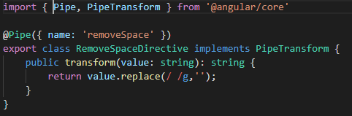
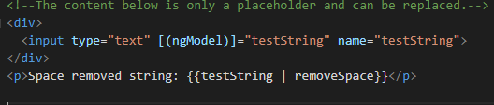
Custom Pipes Exercise
Creating custom pipes
Create a class
Implement PipeTransform interface (@angular/core)
Implement transform() method

Slide 40
Component Interaction
Splitting app into multiple components
App
App
Products
Products
Product Form
Product Detail

Slide 41

Component Interaction
Overview
App
Event Binding
“productCreated” event
Users
Product
Form
Property Binding
“product” property

Slide 42
Component Interaction
Binding to Custom Properties
Pass data from parent to child component
@Input() decorator
Binding to Custom Events
Emitting event from child component
@Output() decorator
EventEmitter<T>
eventEmitterObj.emit()

Slide 43
Services
AJAX
Request
CLIENT
Shopping Cart
Quick Look
SERVER
App
Products
Product Detail
(Products API)
Product
Form
Orders

Slide 44
Services
AJAX
Request
CLIENT
Shopping Cart
SERVER (Products API)
Quick Look
ProductsService
App
Products
Product Detail
Product
Form
Orders

Slide 45
Services
A class with a narrow, well-defined purpose
For e.g.
Logging service
Data service
Tax calculator
App configuration
Message bus
Acts as a central repository/business unit
Creating a service
Injecting a service into a component
Constructor
Providers
Component level
Module level
Injecting a service into another service
@Injectable()

Slide 46
Services
How to create?
Understanding
Dependency Injection
Injector
Injector
Provider
Products Service
Logger Service
ProductsService
LoggerService
products.component.html
<app-product-list></app-product-list>
<app-product-detail></app-product-detail>
Angular
What to create?
ProductListComponent
ProductDetailComponent
Constructor(ProductsService)
Constructor(ProductsService)

Slide 47
Services
Controlling the creation of instances of a Service
Same instance of Service is available Application wide
AppModule
Same instance of Service is available for all
Components (but not for other services)
AppComponent
Any other
Component
Same instance of Service is available for the
Component and all its child Components

Slide 48
Services
Cross component communication using a service
In the service, expose an event object of type EventEmitter
From the source component, invoke emit() method, pass necessary data as an argument
From the destination component subscribe to the service’s event object using subscribe()
method, pass callback function as an argument
App
myService.someEvent.subscribe( (data) => console.log(data)
);
C1
C2
C3
C4
C5
MyService
someEvent: EventEmitter<T>
C6
C7
C8
myService.someEvent.emit(data);

Slide 49
Routing
Setting up routes (@angular/router module)
Routes
Define a constant appRoutes of type Routes
RouterModule.forRoot()
Register the routes with RouterModule.forRoot()
Include this in imports array of app module
Loading Routes
<router-outlet> directive
Navigating with Router Links
routerLink directive
Navigating Programmatically
Import Router from @angular/router

Slide 50
Observables
Used to handle asynchronous tasks / operations
Can be thought of as a data source
E.g. User input event, Http requests
Object we import from a third-party package – rxjs
Follows Observable pattern
Observable
Stream – timeline
Multiple events/data packages emitted by the observable, depending on the data source
Observer – your code
3 ways of handling data packages
Handle Data
Handle Error
Handle Completion

Slide 51
Observables
Observable – rxjs/Observable
Observable.interval()
Observable.create()
Observer - rxjs/Observer
Observer.next()
Observer.error()
Observer.complete()
Observable.subscribe() – returns Subscription (rxjs/Subscription)
Subject
Subject.next()
Subject.subscribe()
http://reactivex.io/rxjs/

Slide 52
Forms
Angular helps
To get form values entered by the user
To check if the form is valid
To conditionally change the way the form is displayed
Two Approaches
Template-Driven Forms
Angular infers the form object from the DOM (Template)
Good for simple forms
Simple validation
Easier to create
Less code
Reactive Forms
Form is created programmatically and synchronized with the DOM
Good for complex forms
More control over validation logic
Unit testable

Slide 53
Forms
Template-Driven Forms
Make sure that FormsModule is imported within the app module
Creating the form
<form> tag need not have these attributes:
action
method
Registering the controls
Include “ngModel” directive
Include “name” attribute
Submitting the form
Include ngSubmit event
<form (ngSubmit)="onSubmit(f)" #f="ngForm">
Understanding form state
Accessing the form with @ViewChild
@ViewChild(‘f’) productForm: NgForm;
User Input Validation
Directives
required, email, minlength, maxlength, pattern
Form State
dirty, touched / untouched, valid / invalid
CSS
ng-dirty, ng-touched / ng-untouched, ng-valid / ng-invalid

Slide 54
Forms
Template-Driven Forms
Using Form State
Disable submit button
<button type=“submit” [disabled]=“!f.valid”>Save</button>
Include CSS classes to provide better user feedback & experience
input.ng-invalid.ng-touched { border: 1px solid red;
}
Display validation messages
<span class="help-block" *ngIf="!productName.valid && productName.touched"> Product name is required.
</span>
Using ngModel with one-way and two-way binding
[ngModel]=“productName”
[(ngModel)]=“productName”
Grouping Form Controls
ngModelGroup=“address”
#addr=“ngModelGroup”
Using Form Data
productForm.value
Resetting Forms
productForm.reset()

Slide 55
Forms
Reactive Forms
More control over form structure and behavior
Easier to unit test
The form is created programmatically
customerForm: FormGroup
FormGroup is imported from ‘@angular/forms’
AppModule
Import ReactiveFormsModule from ‘@angular/forms’
Add ReactiveFormsModule to ‘imports’ array within @NgModule decorator
Creating a form in code
Preferably use ‘ngOnInit()’ to create the form
this.customerForm = new FormGroup({
‘firstName’: new FormControl(‘default-value’, validator), ‘lastName’: new FormControl(‘default-value’, validator)
});

Slide 56
Forms
Reactive Forms
Linking HTML and Form
Use ‘formGroup’ directive to link <form> and form object
<form [formGroup]=“customerForm”>
Use ‘formControlName’ directive to link form control and form object’s property
<input type=“text formControlName=“firstName”>
Submitting the form
Use ‘ngSubmit’ event
<form [formGroup]=“customerForm” (ngSubmit)=“onSubmit()”>
Adding Validation
Pass validator(s) as second parameter to FormControl object
this.customerForm = new FormGroup({
‘firstNamee’: new FormControl(null, Validators.required),
‘lastName’: new FormControl(null, [Validators.required ])
});
Import Validators from ‘@angular/forms’
Mention required attribute in input HTML component
<input id="name" class="form-control" formControlName=“firstName" required>

Slide 57
Forms
Reactive Forms
Getting access to controls
formObj.get(‘control-name’)
E.g.
<span *ngIf=“!customerForm.get(‘firstName’).valid” class=“help-block”> FirstName is required.
</span>
Showing Specific Validation Errors
<div class="help-block"
*ngIf=" customerForm.get(‘firstName’)..touched && customerForm.get(‘firstName’)..invalid">
<div *ngIf=" customerForm.get(‘firstName’)..errors.required"> firstName is required.
</div>
</div>

Slide 58
Forms
Reactive Forms
Validating the Form Upon Submit
Component
this.form.setErrors({ invalidCustomer: true
});
Template
<div class="alert alert-danger" *ngIf="form.errors"> Customer data is invalid!
</div>

Slide 59
Forms
Reactive Forms
Nested FormGroups
this.form = new FormGroup({
name: new FormControl('', Validators.required), contact: new FormGroup({
phone: new FormControl('', Validators.required), email: new FormControl('', Validators.required)
}),
city: new FormControl('', Validators.required)
});
Template
<div formGroupName="contact">
<div class="form-group">
<label for="customerPhone">Phone</label>
<input type="text" class="form-control"
id="customerPhone” name="customerPhone” formControlName="phone">
</div>
<div class="form-group">
<label for="customerEmail">Email</label>
<input type="text" class="form-control”
id="customerEmail” name="customerEmail” formControlName="email">
</div>
</div>

Slide 60
Forms
Reactive Forms – FormBuilder
Creating form control instances manually can become repetitive when dealing with multiple forms. The FormBuilder service provides convenient methods for generating controls.
The FormBuilder service has three methods: control(), group(), and array(). These are factory methods for generating instances in your component classes including form controls, form groups, and form arrays.

Slide 61
Forms
Reactive Forms
Import the FormBuilder class from the @angular/forms package.
Create Forms using FormBuilder
export class CustomerFormComponent {
form: FormGroup;
constructor(private fb: FormBuilder) {
this.form = this.fb.group({
name: ['', Validators.required],
contact: this.fb.group({
phone: ['', Validators.required], email: ['', Validators.required]
}),
city: ['', Validators.required]
});
}
}

Slide 62
Server Communication
HttpClient – ‘@angular/common/http’
Performs http requests using XMLHttpRequest
Getting Data
App Module
Import ‘HttpClientModule’ from ‘@angular/common/http’
Add ‘HttpClientModule’ to ‘imports’ array
Constructor
Inject ‘HttpClient’ instance in the constructor
Import ‘HttpClient’ from ‘@ angular/common/http’
Get data
Use this.http.get<Customer[]>(this.customersUrl, httpOptions) method to create the get request
Http.get() returns Observable<Response>
Use subscribe() method of the Observable
responseObj.json() with actually return the data
Creating Data
this.http.post<Customer>(this.customersUrl, data, httpOptions)
The Response object contains the newly created object

Slide 63
Server Communication
Updating Data
this.http.put<Hero>(this.heroesUrl, hero, httpOptions)
this.http.patch<Hero>(this.heroesUrl, hero, httpOptions)
The Response object contains the updated object
Deleting Data
this.http.delete(url, httpOptions)
OnInit Interface
Constructor should be lightweight and should not perform expensive operations
Do not call Http services in the constructor of the component
Use OnInit.ngOnInit() method for initialization

Slide 64
Server Communication
Separation of Concerns
Single responsibility
Do not include http service calls in the component
Handling Errors
Unexpected errors
Server is offline
Network is down
Unhandled exceptions
Expected errors
Not found error (HTTP error code 404)
Bad request error (HTTP error code 400)

Slide 65
Server Communication
The Catch operator
saveCustomer(data: Customer): Observable<Customer> {
return this.http.post<Customer>(this.customersUrl, data, httpOptions).pipe(
catchError(this.handleError<Customer>('addCustomer')));
}
private handleError<T>(operation = 'operation', result?: T) {
return (error: any): Observable<T> => {
console.error(error); // log to console instead
return of(result as T);
};
}

Slide 66
Server Communication
Global Error Handling
Create a class – AppErrorHandler – that implements ErrorHandler from ‘@angular/core’
Implement ‘handleError()’ method in this class
In the app module, register ‘AppErrorHandler’ in ‘providers’ array
providers: [
{ provide: ErrorHandler, useClass: AppErrorHandler }
]
The Map Operator
import 'rxjs/add/operator/map';
return this.http.get(‘api-url’)
.map( response => response.json() );

Slide 67
Server Communication
Observables vs Promises
Observables
Lazy
Can be converted into promises using toPromise() operator
Handle multiple values over time
Cancellable
Promises
Eager
Do not have operators like in Observables
Called only once and will return a single value
Not cancellable

Slide 68
Q & A
Thank you!

